Slide 1
Grand Lake Rec Club
2020 and 2021 Yearly Review

Slide 2
Treasure Report
Donations to Rec Club
Bill Place Memorial Donation $600
Beach Jams $650
Sportsman Cub $370
Anonymous for State Sonar $1400
Boat lift repair install Boat/labor $300
Misc. $252
Donations from Rec Club
State Sonar $2799
Channel Sign Project with LIA $279
Lighted Buoy Test Program $1175
Safety Lights/Batteries $2678

Slide 4
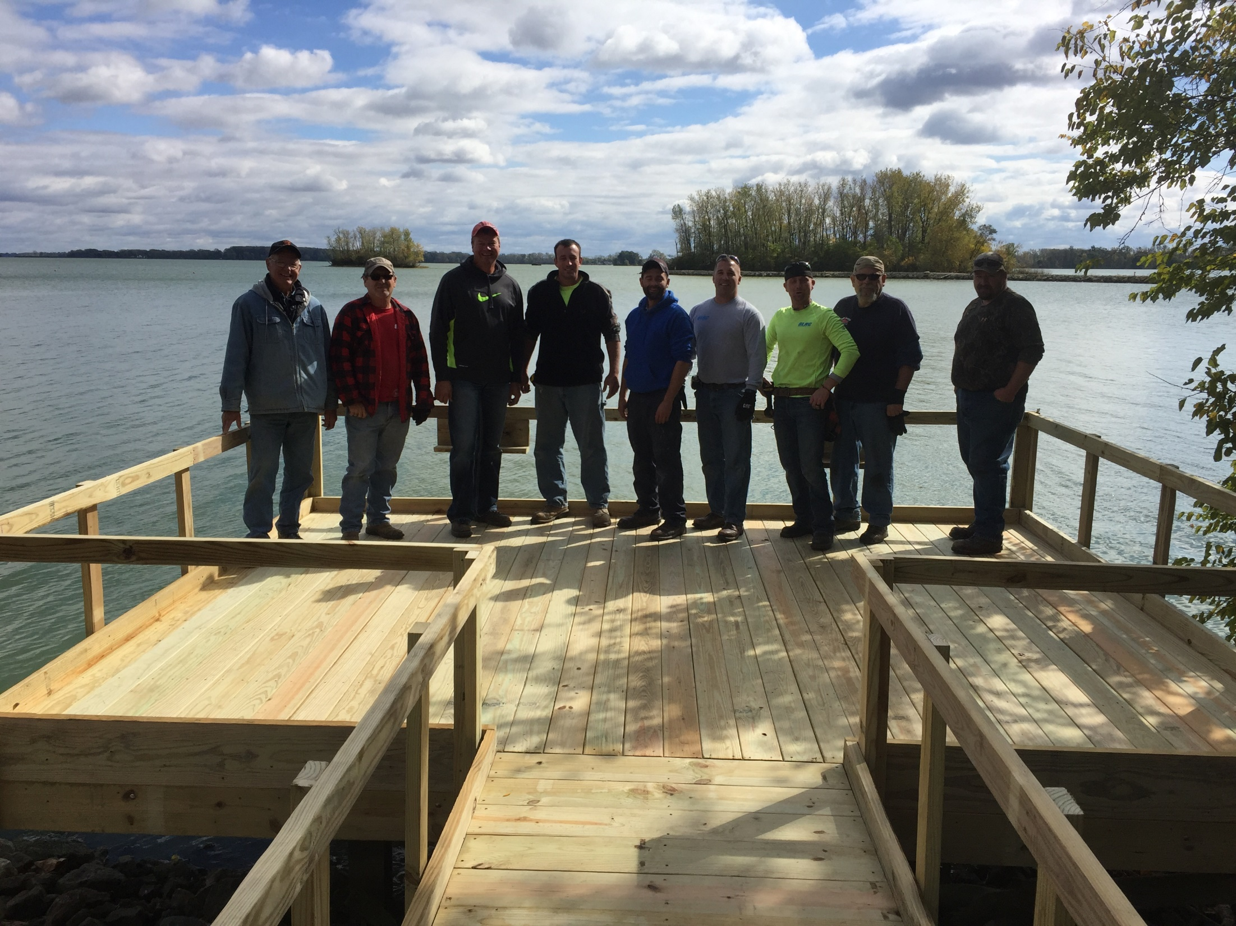

Slide 5
Fish Structure

Slide 6
Spring Lake Clean Up
Pulled various articles of trash
Trimmed Channels
Pulled stumps that were able to be pulled

Slide 7
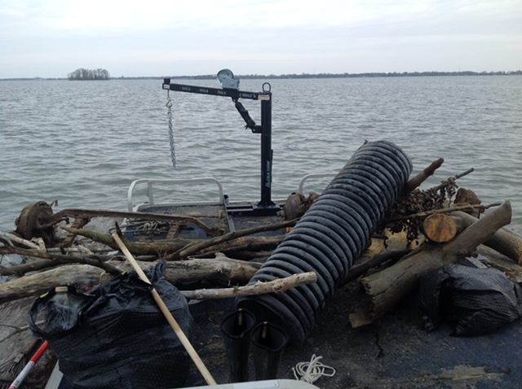
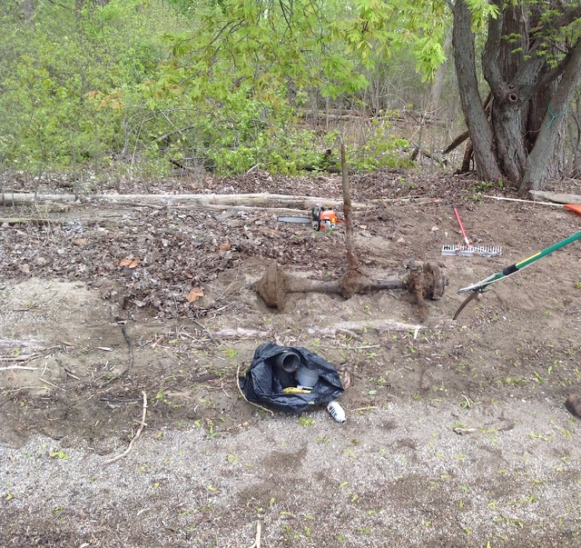
Spring Lake Clean Up

Slide 8
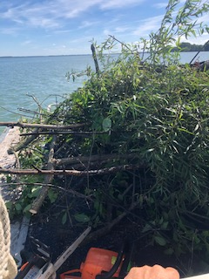
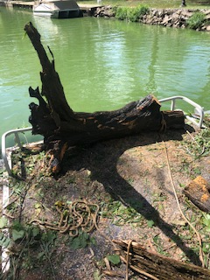
Spring Lake Clean Up

Slide 9
Ditch Clean
Trash pic up along 219 from Doss Landing to Karifit Rd
4 Times annually

Slide 10
Beach Clean Up
Cleaned up 3 beaches this year
Boaters Beach (Amy’s Beach)*
Prairie Creek Beach
Harbor Point Beach

Slide 11
Beach Clean Up-Boaters Beach

Slide 12
Beach Clean Up – Prairie Creek

Slide 13
Beach Clean Up – Prairie Creek

Slide 14
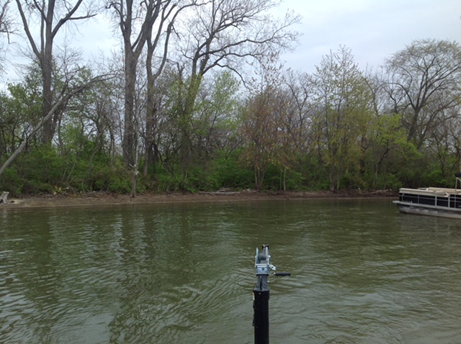
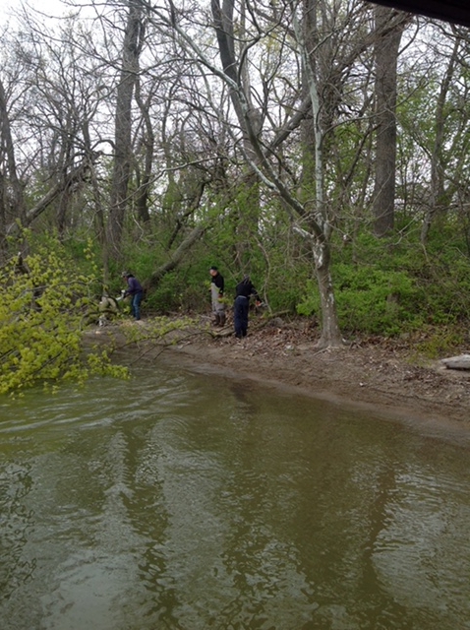
Beach Clean Up – Harbor Point

Slide 15
Poker Run
Poker was a success
$4242.00 raised
379 total people registered
Next one - June 11, 2022

Slide 16
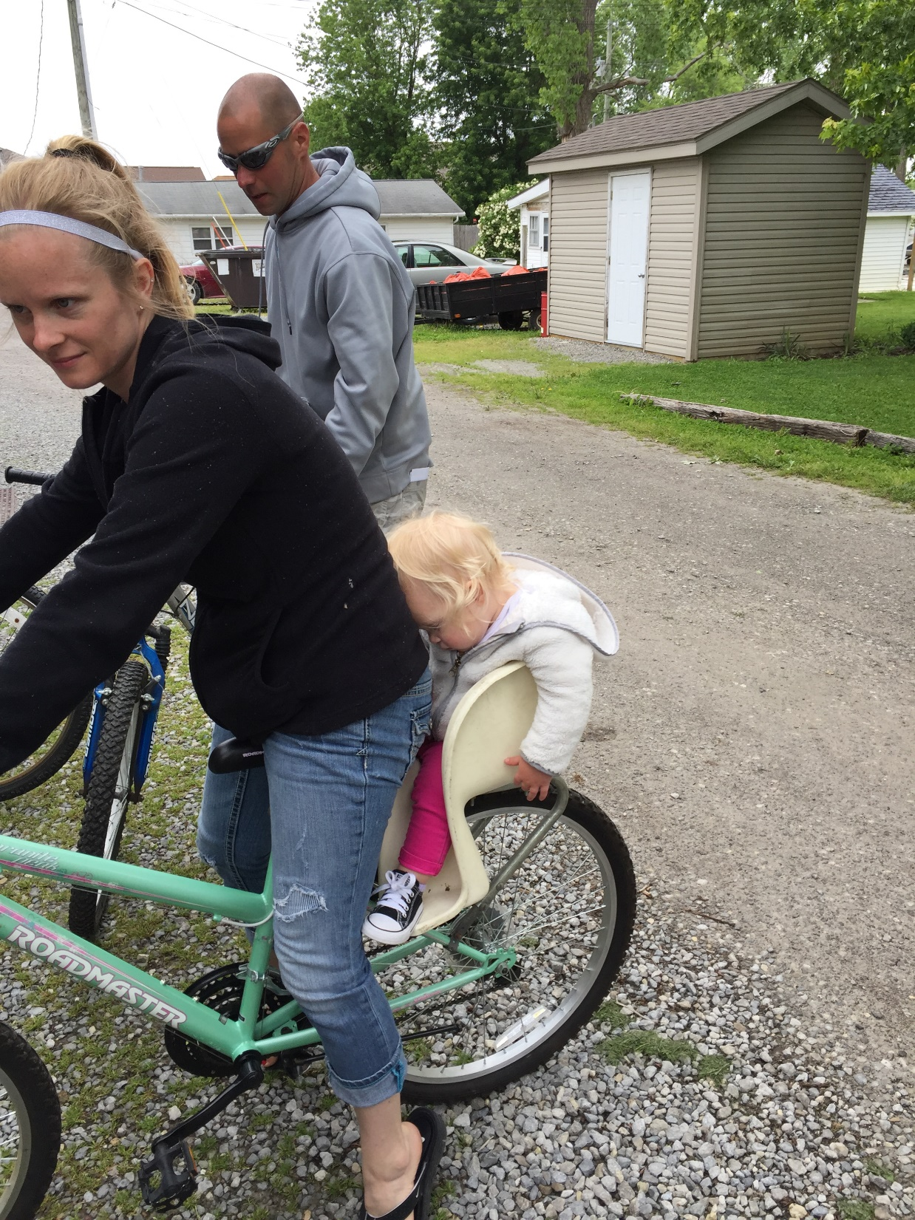
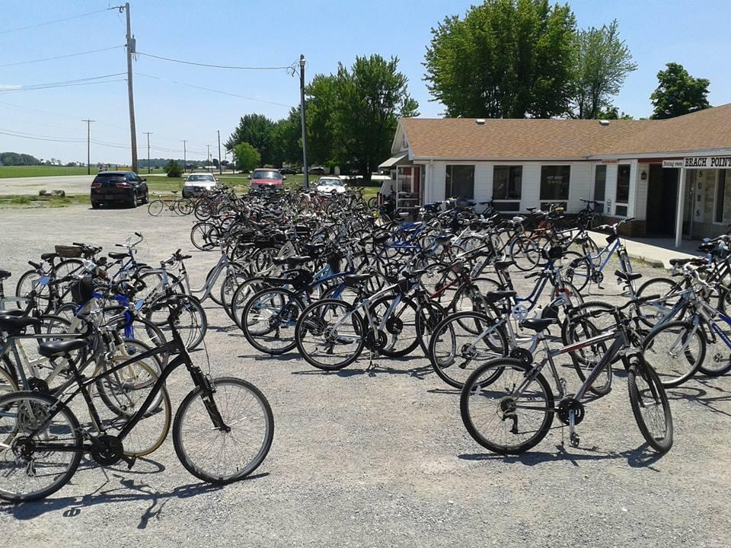

Slide 17
Beach Jams
July 4th
July 31st
August 28th
All were a great success had wonderful feedback
Dates for next year
July 3rd
July 30th
August 27th

Slide 18
Beach Jams

Slide 19
Beach Jams

Slide 20
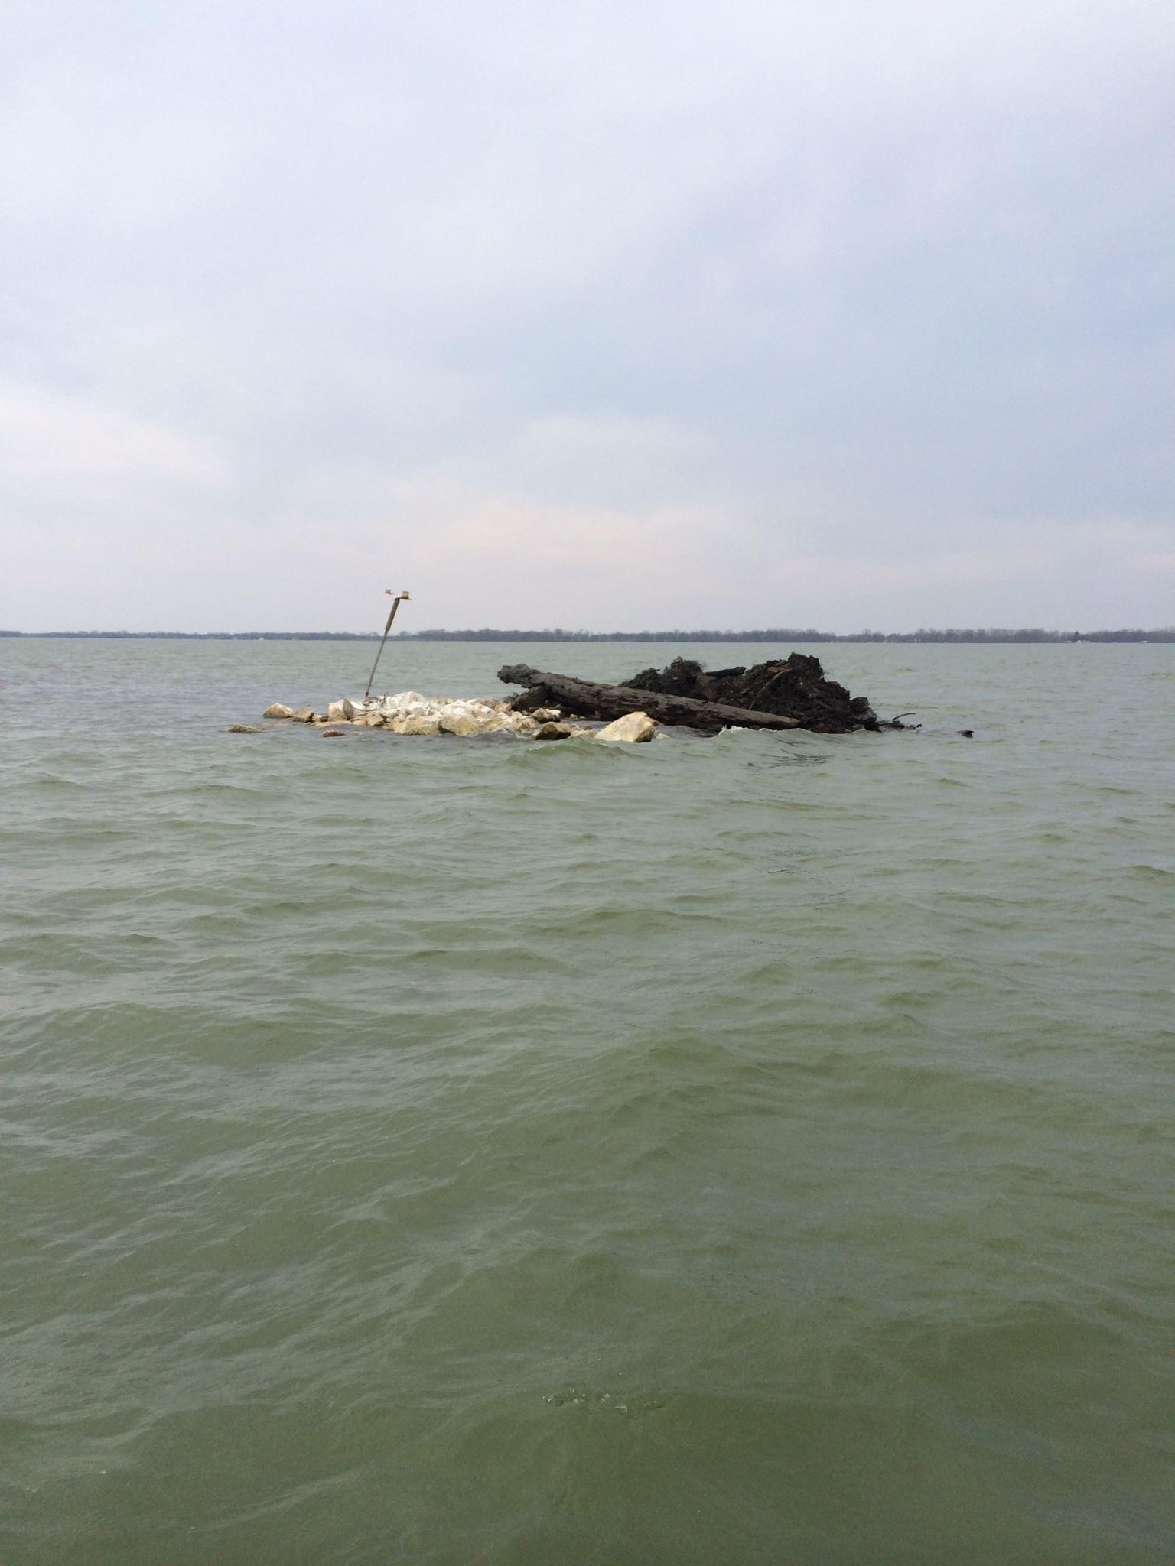
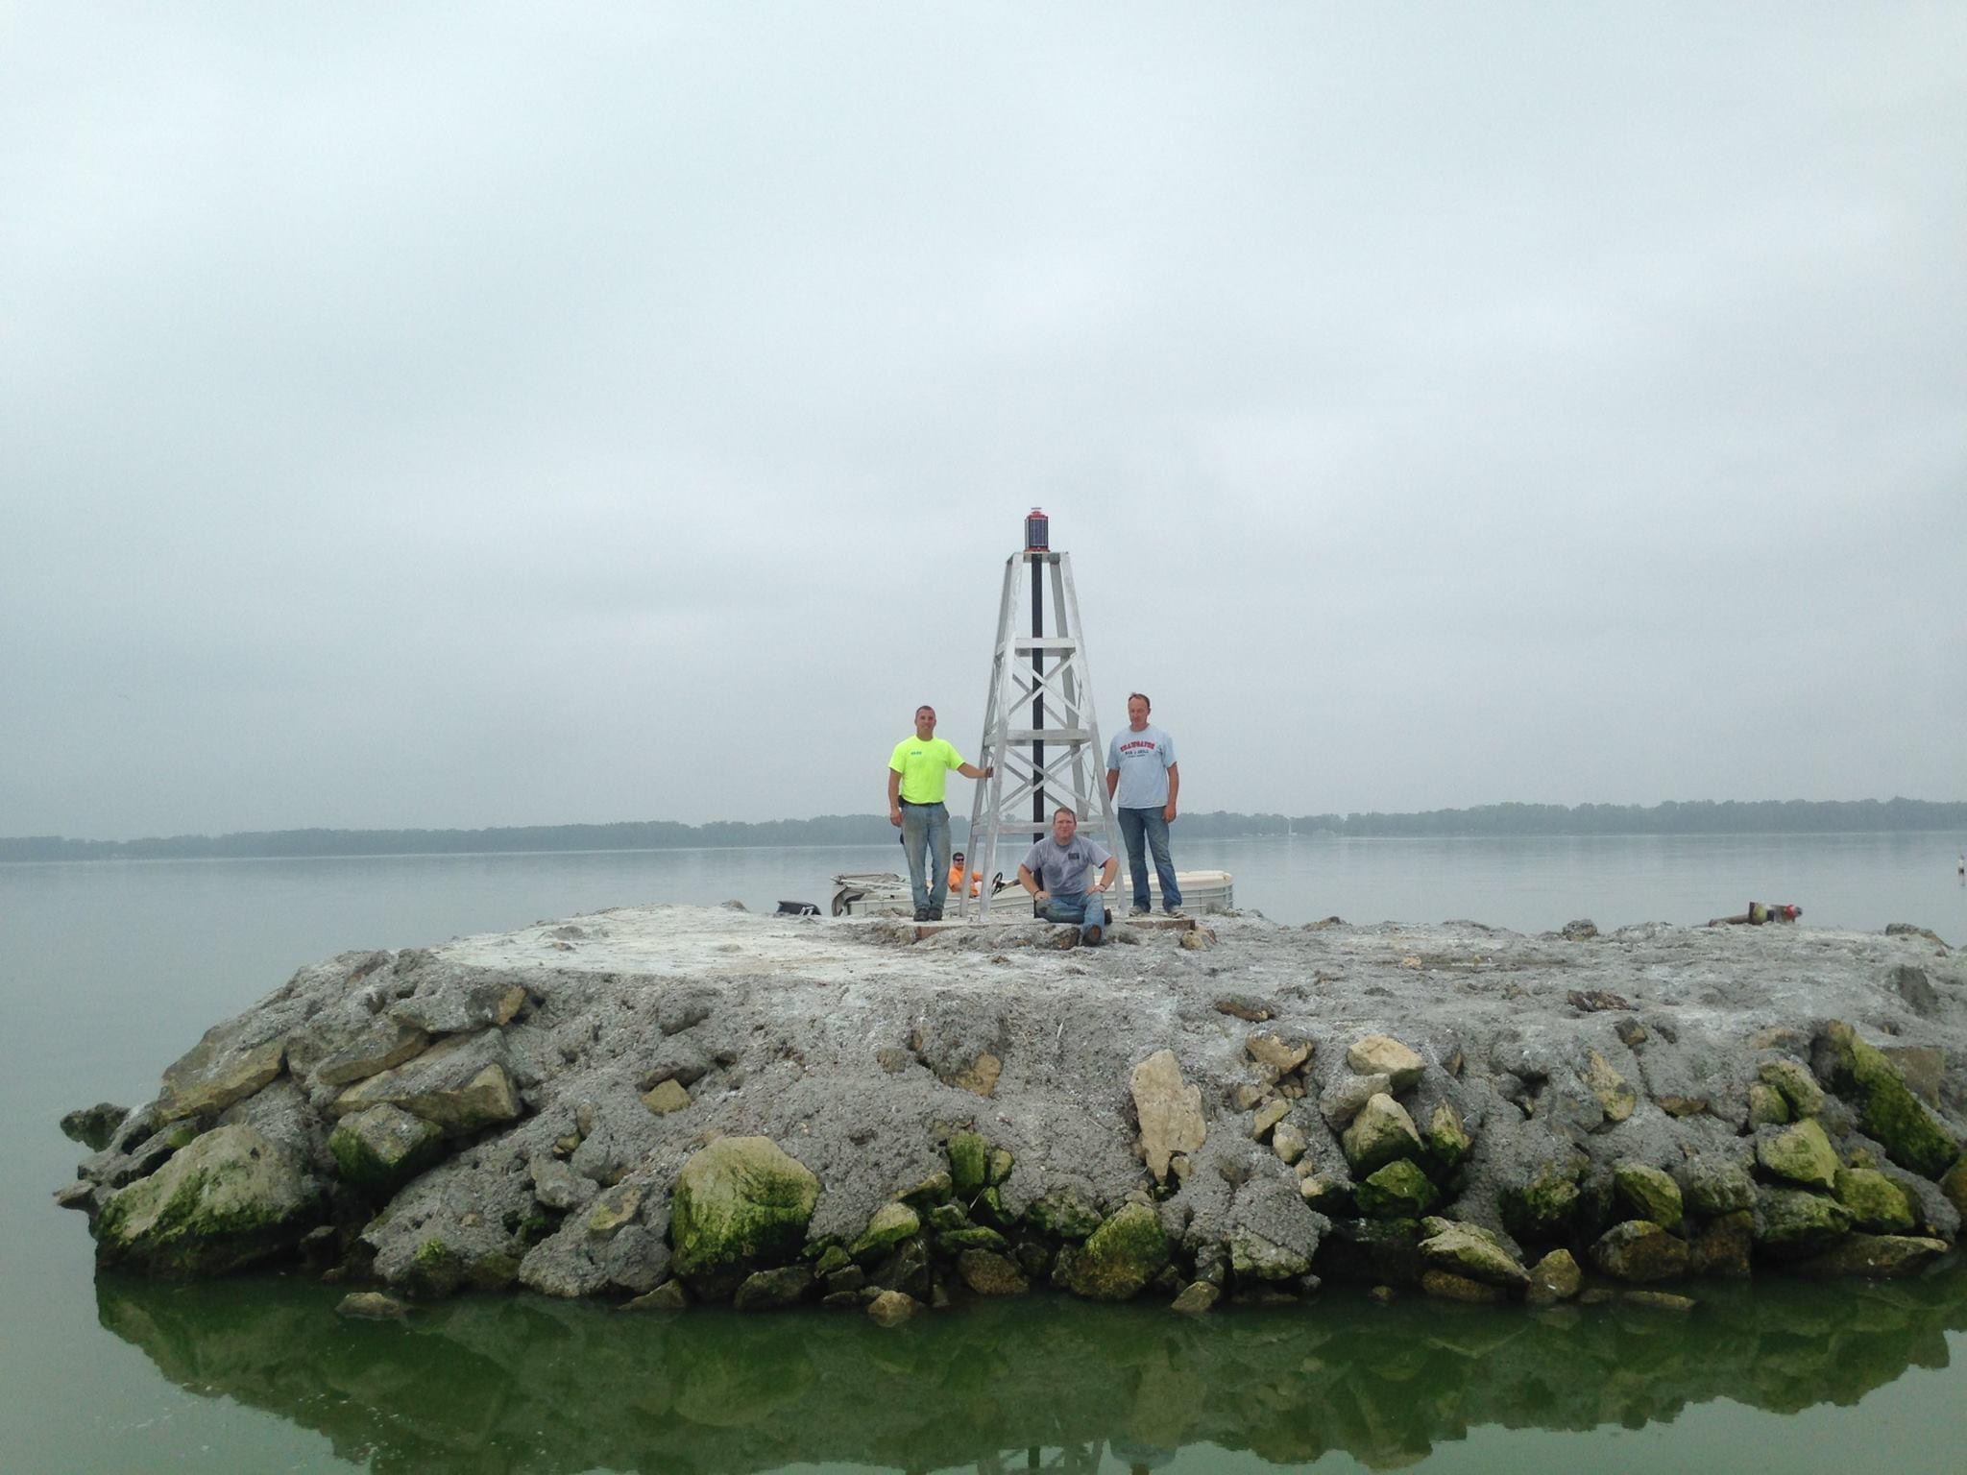
Spring 2014
Fall 2014

Slide 21
Oil Derrick

Slide 22
Grand Lake Marathon

Slide 23
Log Dog Updates

Slide 24
Log Dog

Slide 25
Channel Lights and Signs
Work in progress
Solar lights have been installed on channel sign (L.I.A Funded)
Adding more signs with lights this spring

Slide 26
Trevor Mobley Foundation
Safety Lights
Lighted Buoys
Construction Buoys
Poles to replace broken or bent safety light poles

Slide 27
Channel Bouys

Slide 28
Buoys

Slide 29
Safety Buckets

Slide 30
2022 Projects
Trevor Mobely Foundation Light Project
Logg Dogg floor replacement
Beach Clean Ups
Ditch Clean Ups
Channel Clean Ups

Slide 31
Thanks For a Wonderful Year !
Looking Forward to 2022

